Slide 1



REGULATOR ASSESSMENT FOOD SAFETY IN MSMEs AND STREET FOOD BUSINESSES in The APEC Region
01 Legality
02 Control/Supervision
03 Foster of Street Vendors
2025

Slide 2

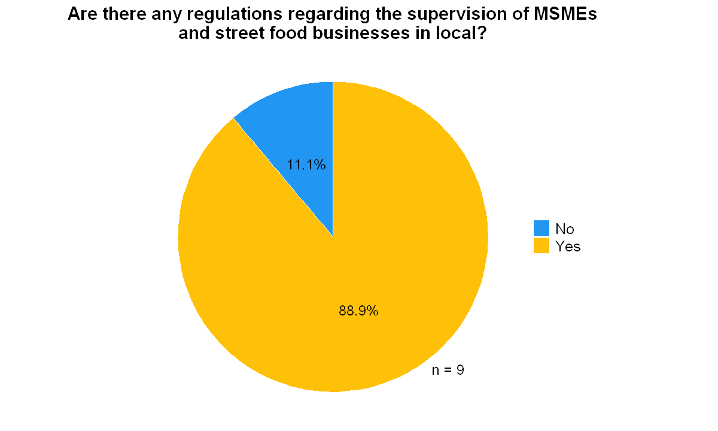
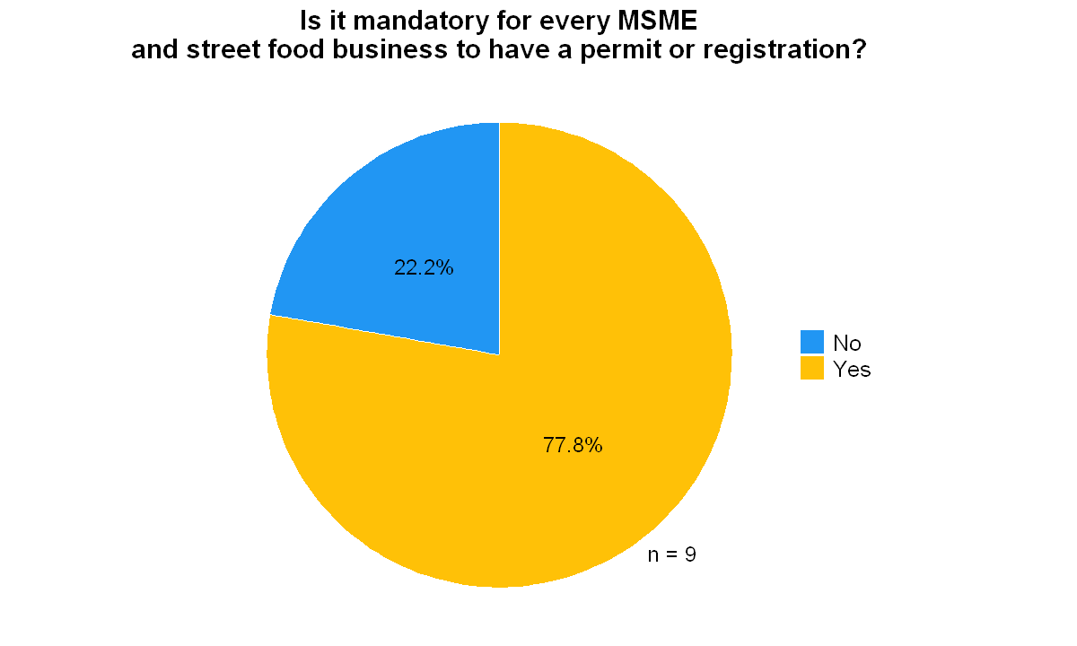

REGULATOR ASSESSMENT
01 Legality [1/5]
Most regulators (88.9%) reported having regulations for supervising MSMEs and street food businesses locally, while only 11.1% indicated no such regulations exist.
Most regulators (77.8%) reported that permits or registrations are mandatory for MSMEs and street food businesses, while only 22.2% indicated that such formal documentation is not required.

Slide 3
REGULATOR ASSESSMENT
01 Legality [2/5]
List of regulation and institution/agency authority to supervise MSMEs and street food businesses

Slide 4
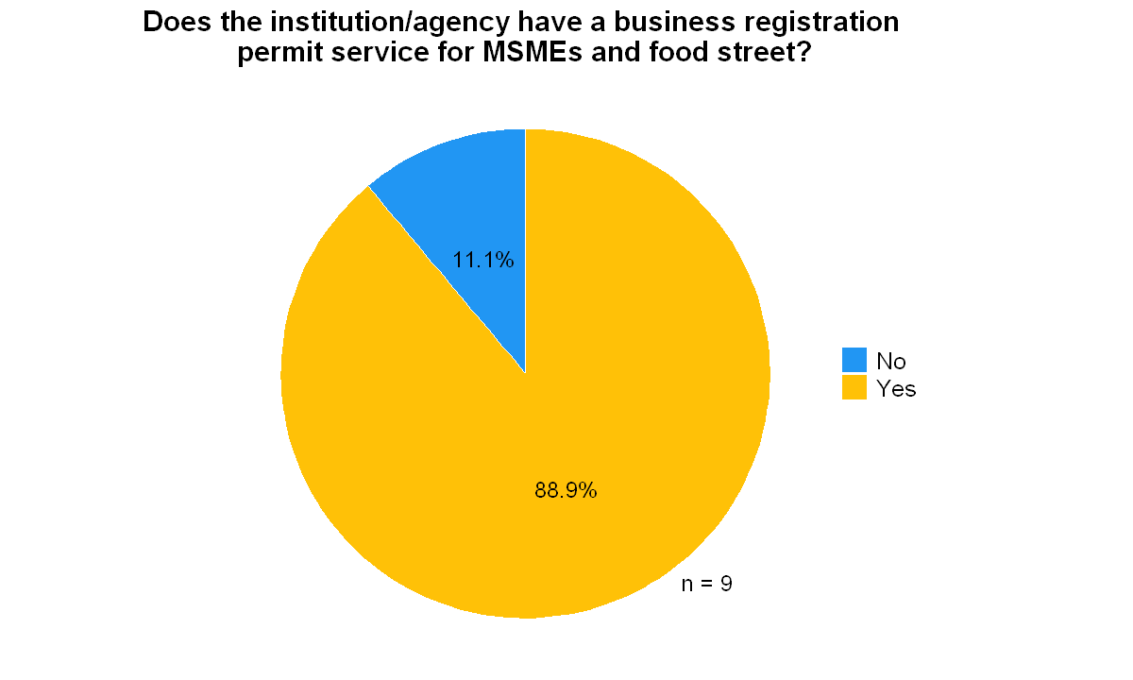
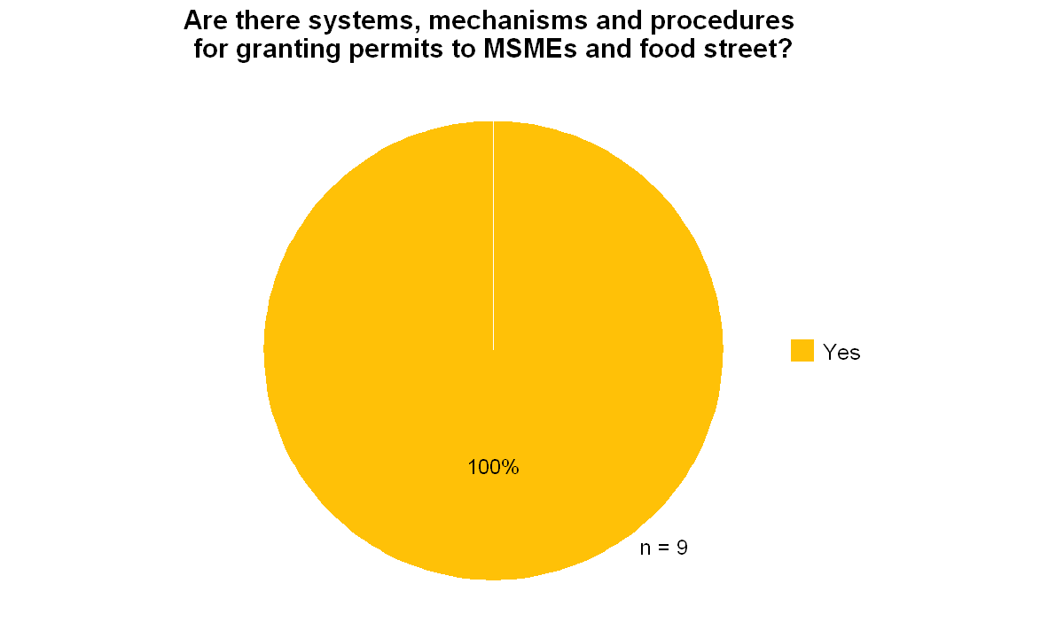
REGULATOR ASSESSMENT
01 Legality [3/5]
Most regulators (88.9%) reported having business registration permit services for MSMEs and street food businesses, while only 11.1% indicated no such services exist.
All regulators (100%) reported having systems, mechanisms and procedures in place for granting permits to MSMEs and street food businesses.

Slide 5
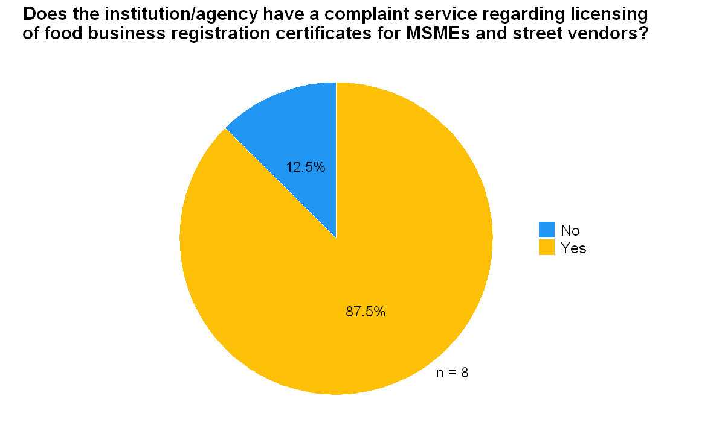
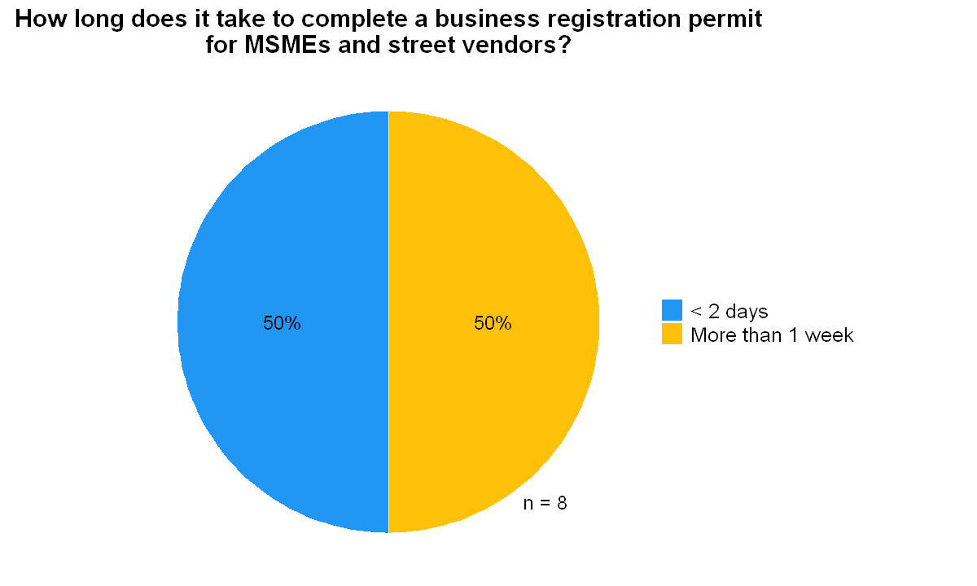
REGULATOR ASSESSMENT
01 Legality [4/5]
Most regulatory agencies (87.5%) provide complaint services related to licensing of food business registration certificates for MSMEs and street vendors, while a small minority (12.5%) do not offer such services.
Half of the regulators (50%) reported that business registration permits can be completed in less than 2 days, while the other half (50%) indicated it takes more than 1 week to process, with no regulators reporting processing times in the intermediate ranges of 3-5 days or 6-7 days.

Slide 6
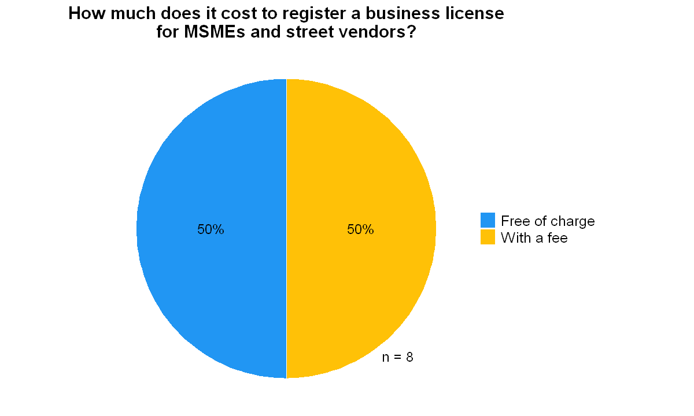
REGULATOR ASSESSMENT
01 Legality [5/5]
Business registration costs are evenly split, with half of regulatory agencies (50%) offering completely free registration services and the other half (50%) charging a fee. No regulators reported offering subsidized registration options.

Slide 7
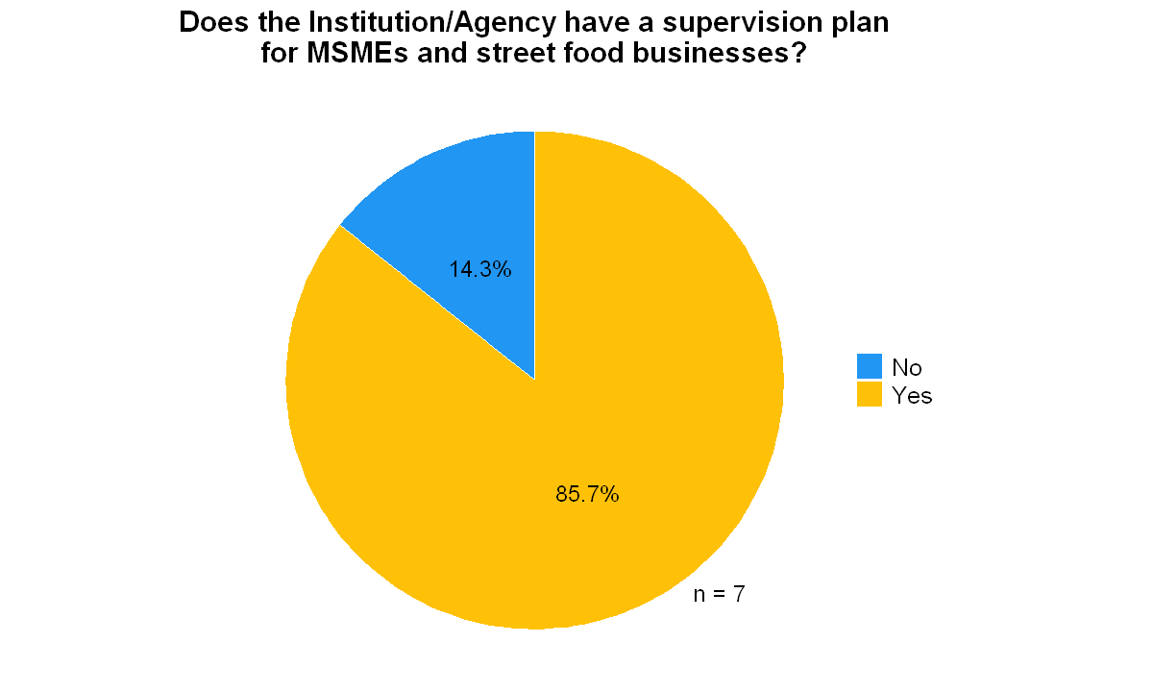

REGULATOR ASSESSMENT
02 Control/Supervision [1/5]
Most regulatory agencies (85.7%) have supervision plans in place for MSMEs and street food businesses, while a small minority (14.3%) do not have formal planning for such oversight activities.
Most regulatory agencies (85.7%) conduct routine and scheduled supervision of MSMEs and street food businesses, while a small minority (14.3%) do not perform such regular oversight activities.

Slide 8

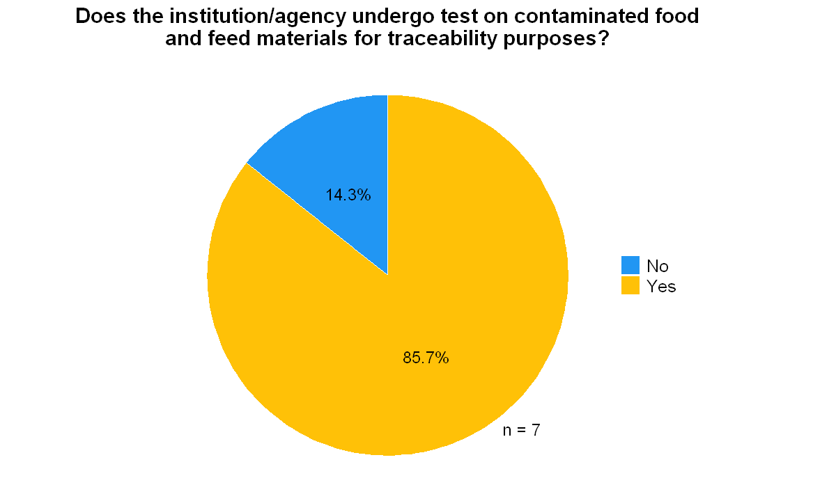
REGULATOR ASSESSMENT
02 Control/Supervision [2/5]
Most regulatory agencies (85.7%) monitor expired products in MSMEs and street vendors in their areas, while a small minority (14.3%) do not conduct such product expiration monitoring.
Most regulatory agencies (85.7%) conduct testing on contaminated food and feed materials for traceability purposes, while a small minority (14.3%) do not perform such testing activities.

Slide 9
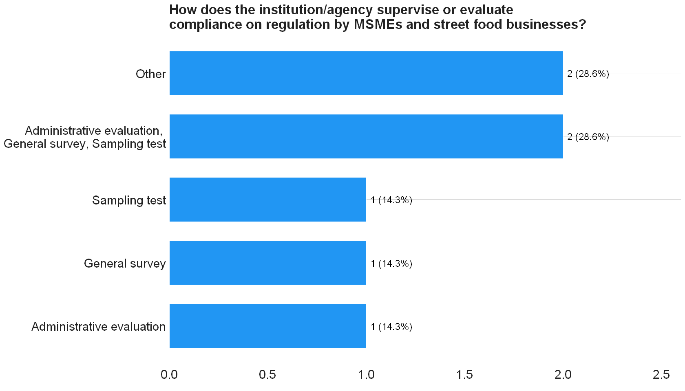
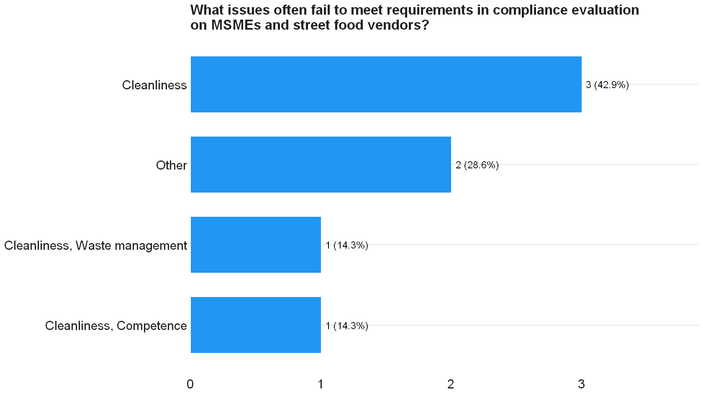
REGULATOR ASSESSMENT
02 Control/Supervision [3/5]
Regulatory agencies employ diverse oversight methods for MSMEs and street food businesses. Of these, 28.6% use comprehensive approaches that combine administrative evaluation, general surveys, and sampling tests. Another 42.9% use single methods such as administrative evaluation, general surveys, or sampling tests individually. The remaining 28.6% use specialized methods like surveillance audits or rely solely on a policy unit.
Cleanliness is the primary compliance issue for MSMEs and street food vendors (42.9%), with additional concerns including cleanliness combined with waste management or staff competence (28.6% combined), and other unspecified issues (28.6%).

Slide 10
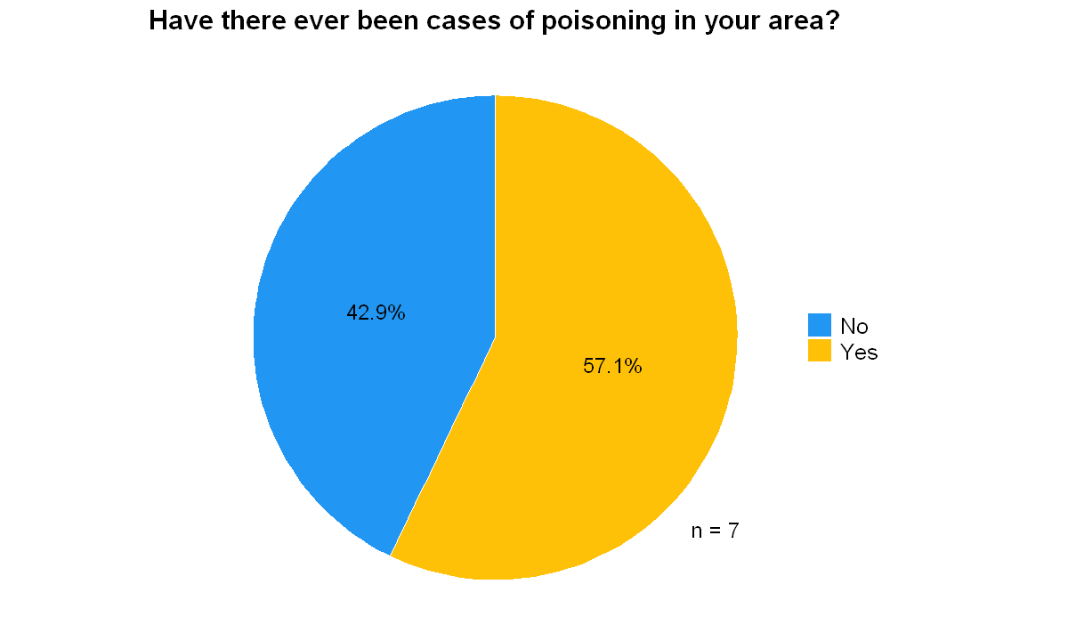
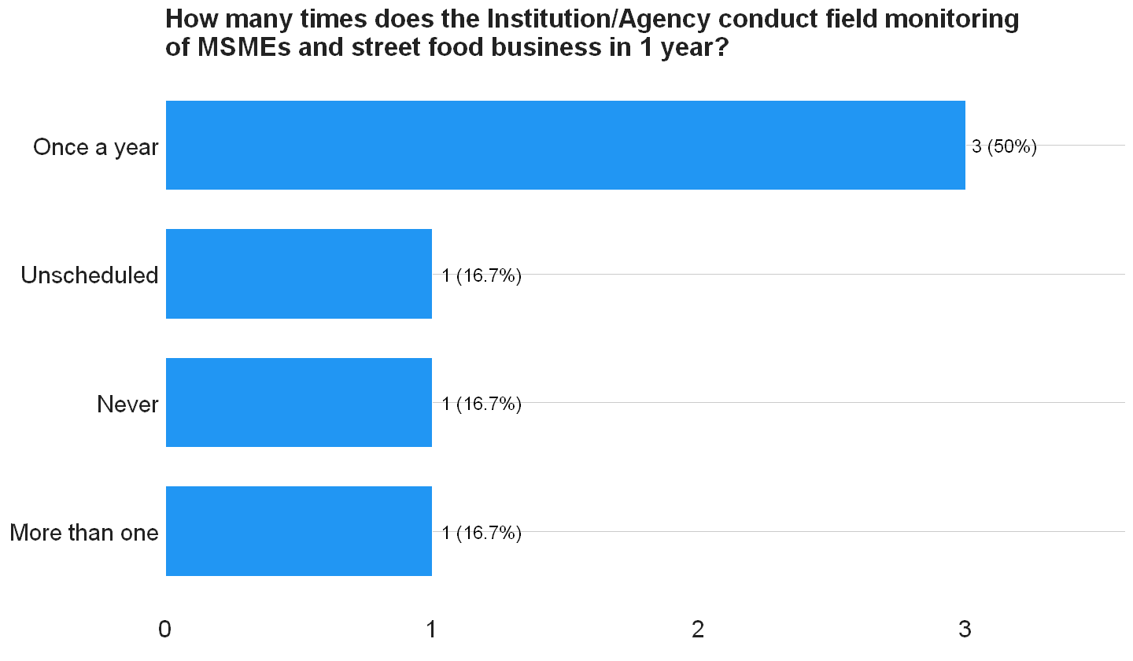
REGULATOR ASSESSMENT
02 Control/Supervision [4/5]
Slightly more than half of regulatory agencies (57.1%) have experienced cases of food poisoning in their areas, while 42.9% have not.
Half of regulatory agencies (50%) conduct field monitoring just once per year, while the remaining agencies are evenly split between those conducting more than once per year, those with unscheduled monitoring, and those that never conduct monitoring.

Slide 11
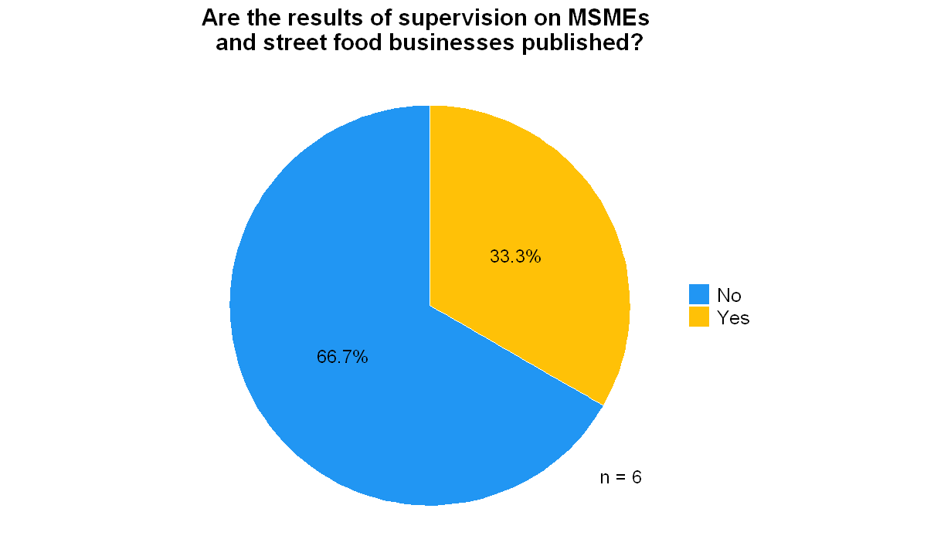
REGULATOR ASSESSMENT
02 Control/Supervision [5/5]
Two-thirds of regulatory agencies (66.7%) do not publish their supervision results for MSMEs and street food businesses, while only one-third (33.3%) make these findings public.

Slide 12
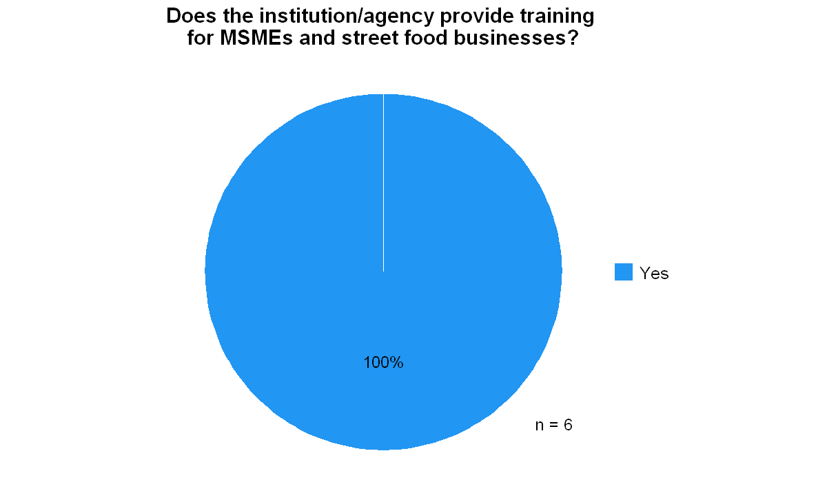
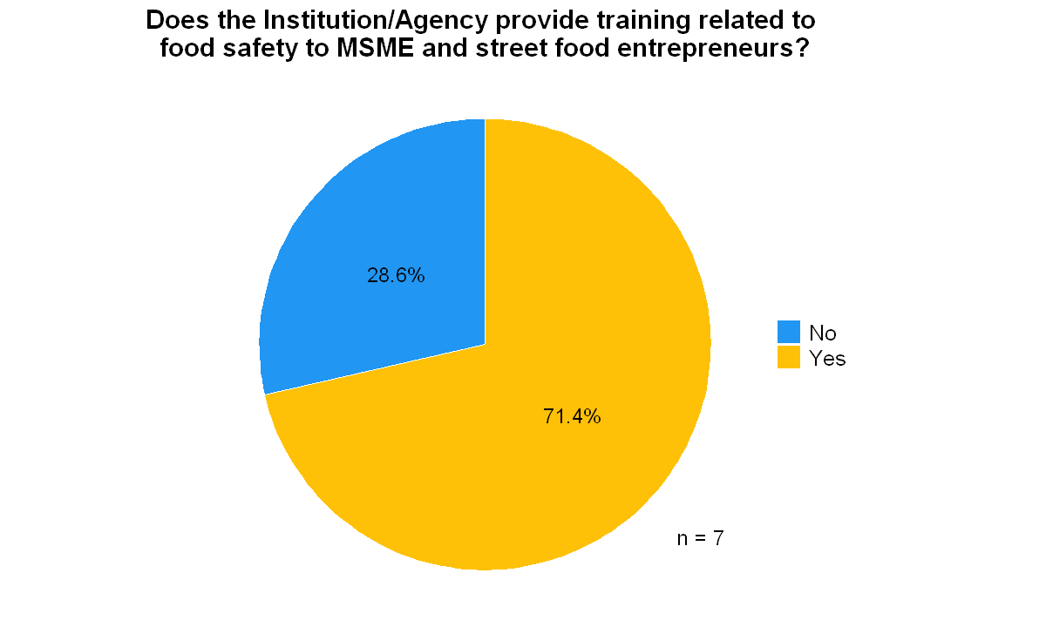
REGULATOR ASSESSMENT
03 Foster of Street Vendors [1/3]
All regulatory agencies (100%) provide training for MSMEs and street food businesses.
A majority (71.4%) of regulatory agencies provide specialized food safety training to MSME and street food entrepreneurs, while 28.6% do not offer such focused training programs.

Slide 13
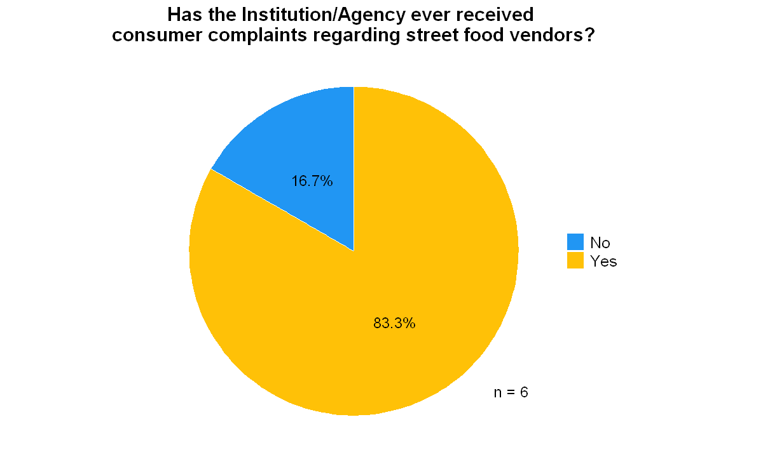
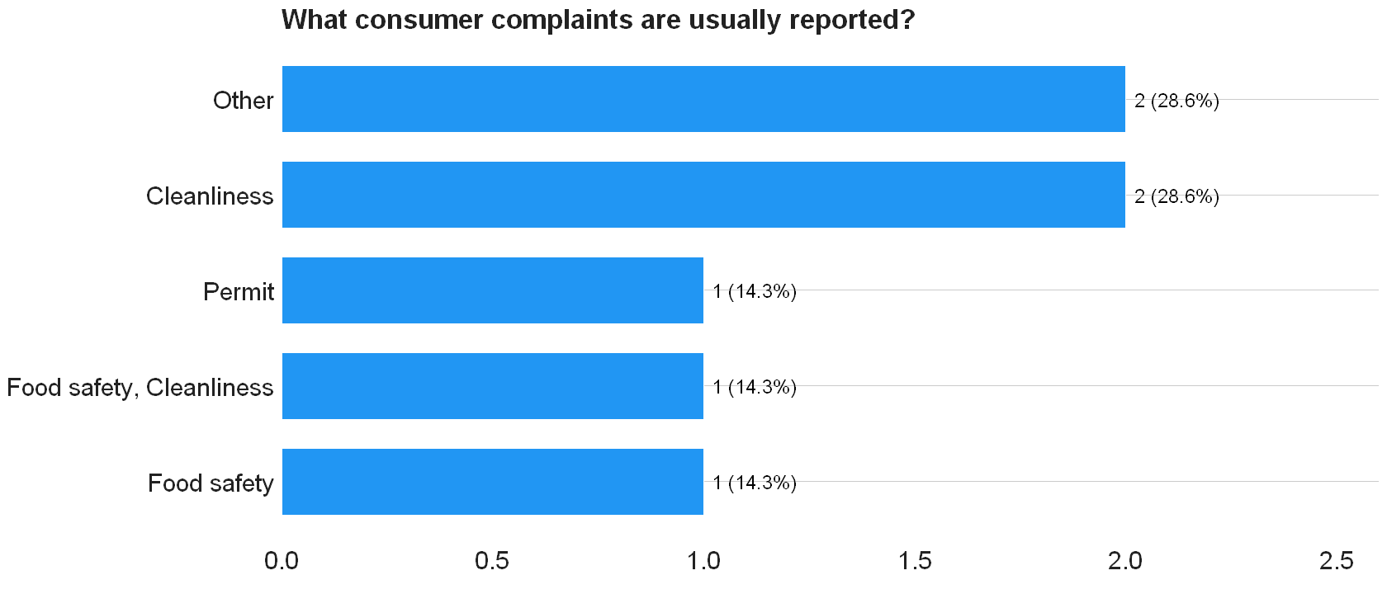
REGULATOR ASSESSMENT
03 Foster of Street Vendors [2/3]
The vast majority of regulatory agencies (83.3%) have received consumer complaints about street food vendors, while only a small percentage (16.7%) report never having received such complaints.
Consumer complaints are mostly about cleanliness (28.6%). The remaining complaints are evenly distributed among food safety issues, combined food safety and cleanliness concerns, and permit-related problems. Other issues include product halalness.

Slide 14
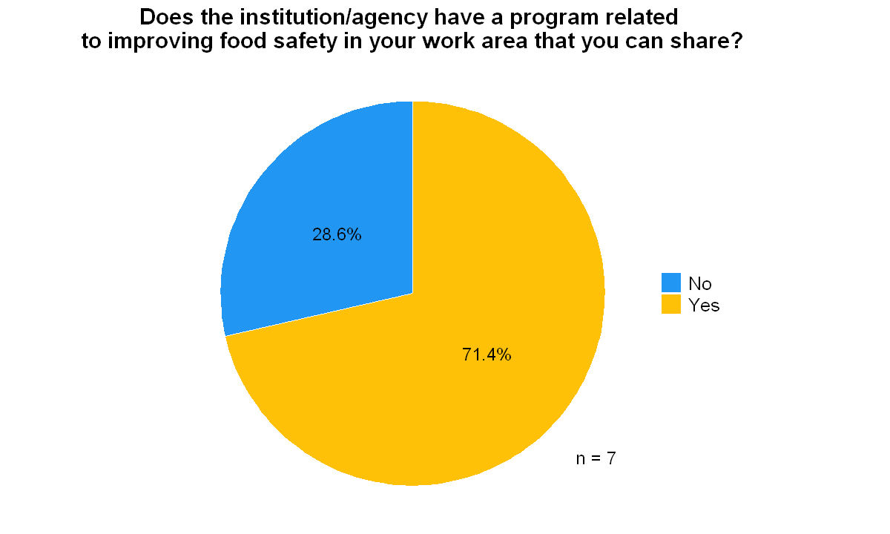
REGULATOR ASSESSMENT
03 Foster of Street Vendors [3/3]
List of program
Most regulatory agencies (71.4%) have established programs related to improving food safety, while 28.6% report not having such shareable food safety improvement programs.

